Slide 1
Operators

Slide 2

Assignment Operator

Slide 3


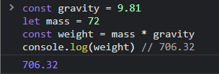

Arithmetic operator

Slide 4
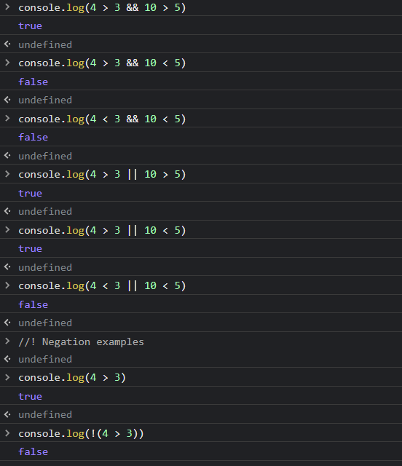
logical Operators

Slide 5
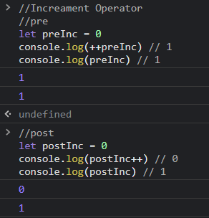
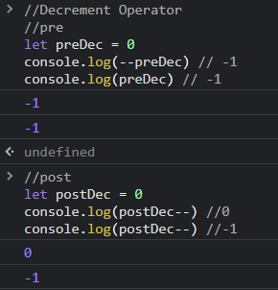
Increment decrement

Slide 6
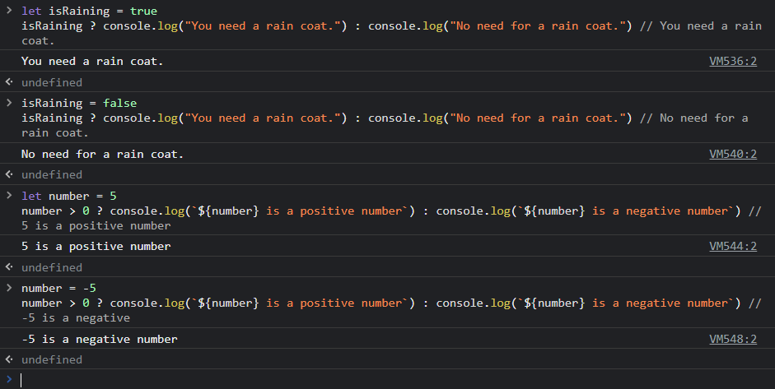
Ternary

